Slide 1
Foodaholic Project
GROUP 01
Instructors:
Mr Nguyễn Văn Vũ
Mr Hồ Tuấn Thanh
Mr Bùi Tấn Lộc
Introduction to Software Engineering - 20CLC07
Foodaholic – Group 01

Slide 2
Preamble
01
Project management
02
TABLE OF CONTENTS
Software requirements
03
Analysis and design
04
Software testing
05
Problem statement, product position statement (from the Vision document), users/market.
Team structure and responsibilities of team members.
Use-case model and Functional – NonFunctional Requirements
Architecture and technologies used.
Enviroments Need, Target test items and Test report
Introduction to Software Engineering - 20CLC07
Foodaholic – Group 01

Slide 3
01
Preamble
Problem statement, product position statement (from the Vision document), users/market.
Introduction to Software Engineering - 20CLC07
Foodaholic – Group 01

Slide 4
Problem statement
Problem | People don’t know how to cook Lack of quality cooking-sharing websites
Affects | Quality of meal People’s health
Impact | No control over about energy/calories
Solution | Providing a place: Share delectable meals Know the total calories of each meal

Slide 5
Product position statement
For | Everyone in Vietnam
Who | want to: - Learning cooking - Sharing recipes
Product name | Foodaholic
Users can | Shares recipes and foods, see each nutrient in the diet, total calories
Special | A list of nutrients and energy consumption
Our product | Website product in PC
Introduction to Software Engineering - 20CLC07
Foodaholic – Group 01

Slide 6
User Summary
Administrators | Manage users and posts
Registered Users | See the recipes Post a recipe Interact in a recipe
Guests | See the recipes
Introduction to Software Engineering - 20CLC07
Foodaholic – Group 01

Slide 7
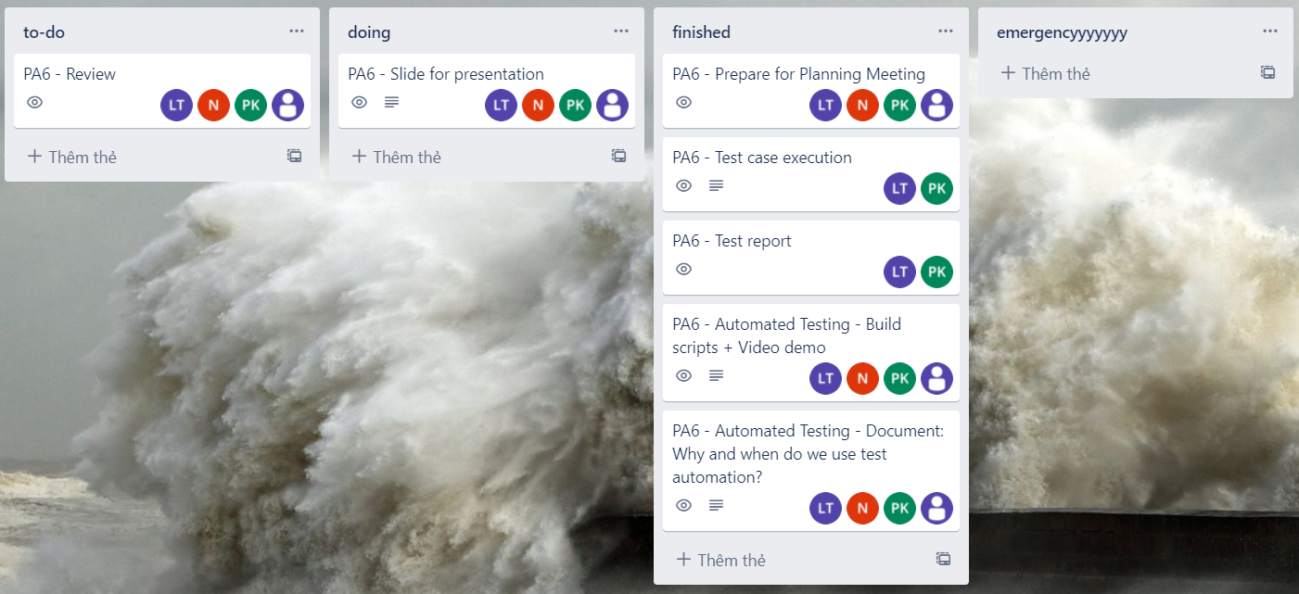
Trello (Doing)
Introduction to Software Engineering - 20CLC07
Foodaholic – Group 01

Slide 8
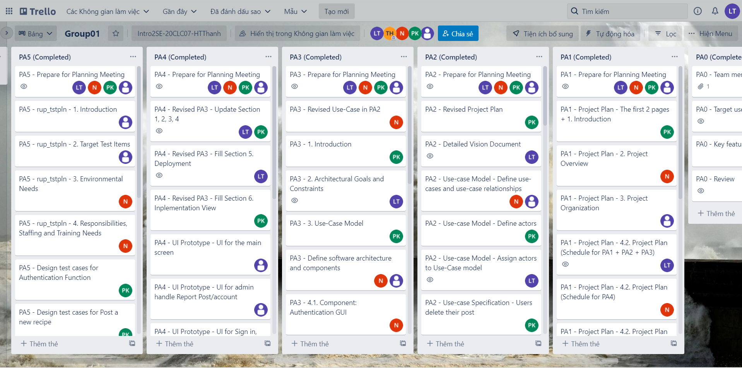
Trello (Done)

Slide 9
02
Project management
Team structure and responsibilities of team members.
Introduction to Software Engineering - 20CLC07
Foodaholic – Group 01

Slide 10
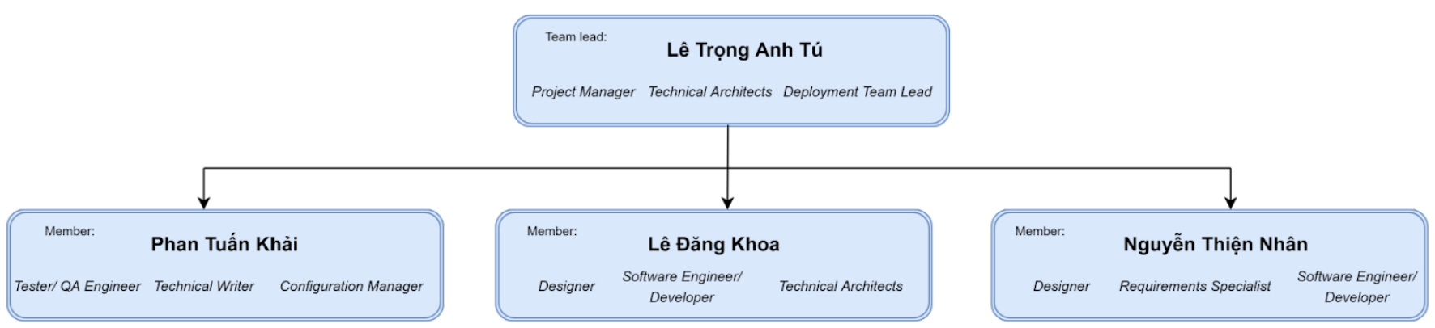
Team structure
Introduction to Software Engineering - 20CLC07
Foodaholic – Group 01

Slide 11
Responsibilities
Name | Responsibilities
Lê Trọng Anh Tú | Set deadline for each tasks Manage the overall project discipline
Nguyễn Thiện Nhân | Implement software program Capture the specification in Use-case
Phan Tuấn Khải | Manage testing operation Write and review all documents
Lê Đăng Khoa | Design UI for our software Implement software program

Slide 12

03
Software requirements
Use-case model and Functional – NonFunctional Requirements
Introduction to Software Engineering - 20CLC07
Foodaholic – Group 01

Slide 13
Use-case model
Use-case model of Foodaholic website
Introduction to Software Engineering - 20CLC07
Foodaholic – Group 01

Slide 14
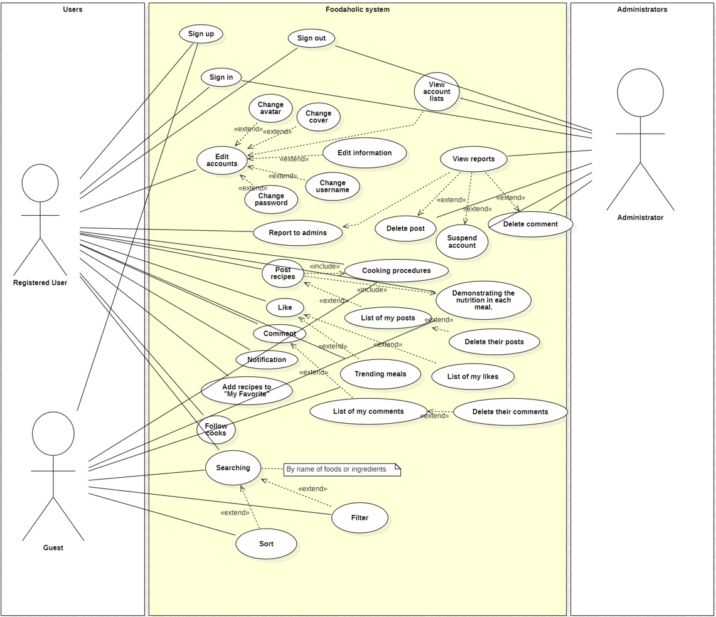
Use-case model
Model elements:
Three actors:
Guest (Un-registered user)
Registered user (Main user of the website)
Admin (User management)
Many use-cases, include:
The features will be developed in the future
The features have been completed
(will be mentioned in the functional requirements)
Introduction to Software Engineering - 20CLC07
Foodaholic – Group 01

Slide 15
Functional Requirements
List of the functionalities that my team have already achieved
Introduction to Software Engineering - 20CLC07
Foodaholic – Group 01

Slide 16
User side:
Functional Requirements
1. Log in
2. Sign up
3. Log in as Guest
4. Post recipes
5. Search recipes
6. Sort search result
7. View derail post
8. List user’s recipes
9. Change information
10. Delete post
11. Report post
12. Report account
13. Comment
14. User's favorite recipes list
15. Give emoji below post
Admin side:
1. View reported posts list
2. View reported accounts list
3. Delete post
4. Suspend account
Introduction to Software Engineering - 20CLC07
Foodaholic – Group 01

Slide 17
Non-Functional Requirements
Specifies criteria that can be used to judge the operation of Foodaholic’s system
Introduction to Software Engineering - 20CLC07
Foodaholic – Group 01

Slide 18
Non-Functional Requirements
1. Compatibility:
The system must be compatible with many different versions of operating systems and browsers
2. Usability:
The web shall be easy-to-use and shall be appropriate for all people.
3. Availability:
System must allows customers to access services 24 hours a day with minimum downtime period for backup and maintenance.
4. Capacity:
The Web must have a large capacity to hold user data, web data, image, …
5. Security:
Encrypt password, user data to protect user account
Introduction to Software Engineering - 20CLC07
Foodaholic – Group 01

Slide 19
04
Analysis and design
Architecture and technologies used.
Introduction to Software Engineering - 20CLC07
Foodaholic – Group 01

Slide 20
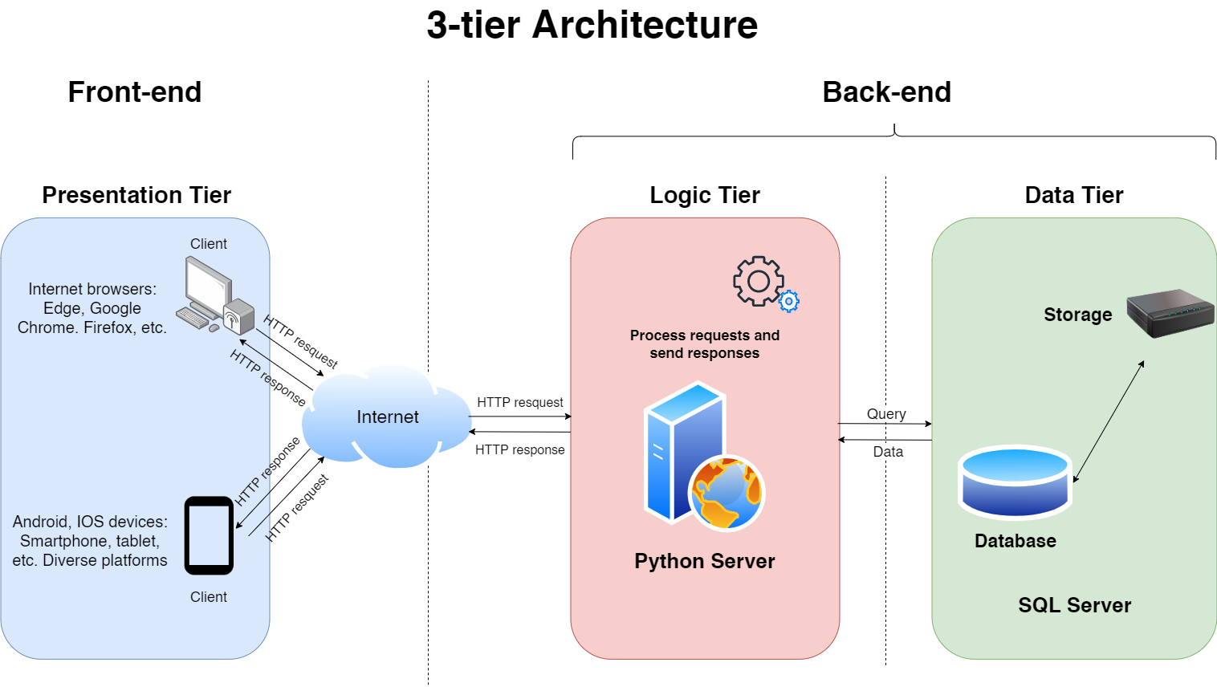
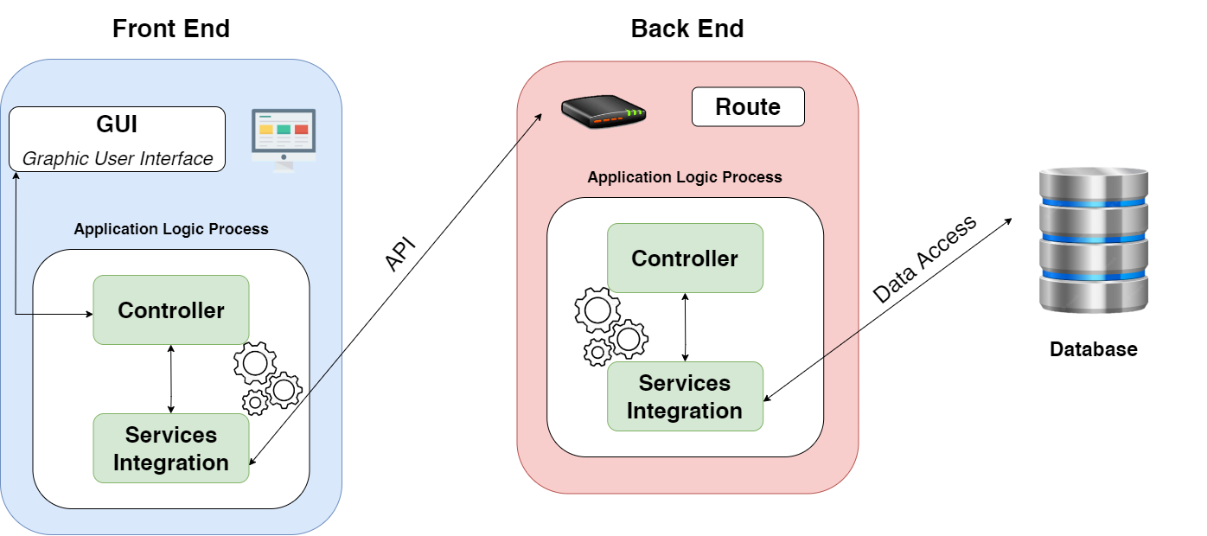
Software Architecture
Introduction to Software Engineering - 20CLC07
Foodaholic – Group 01

Slide 21
Components
GUI components:
Authentication GUI
Post GUI
Admin GUI
User management GUI
Searching GUI
Controller components:
Authentication Controller
Post Controller
Admin Controller
User management Controller
Searching Controller
Service Integrations

Slide 22
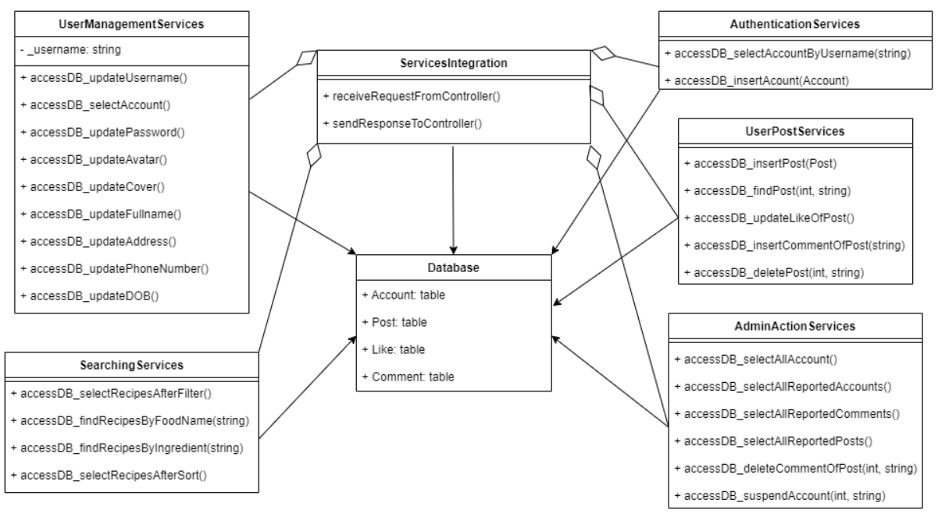
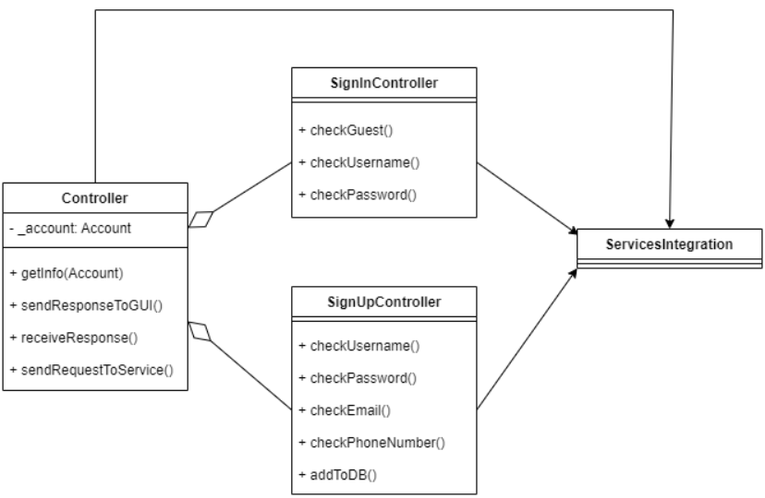
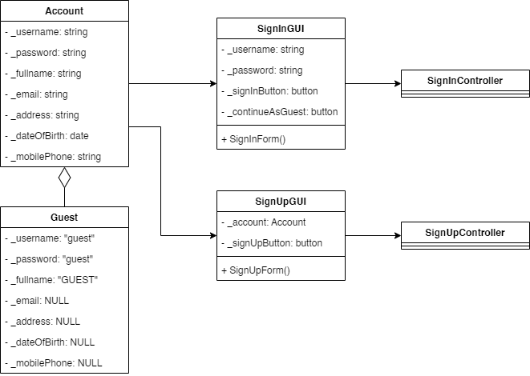
Authentication Components

Slide 23
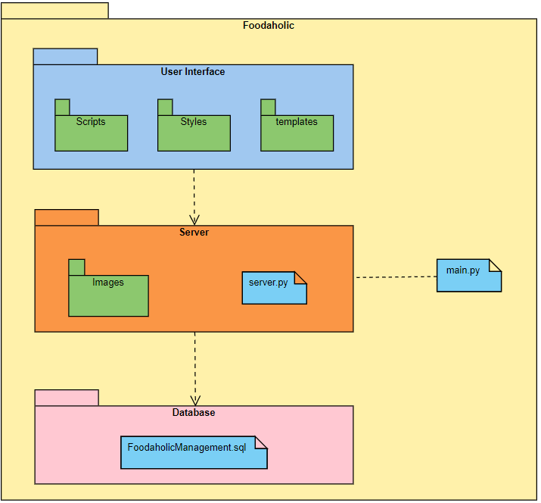
Implementation view
User Interface:
templates: save HTML files
Styles: save CSS files
Scripts: save JavaScript files
Server:
Images: save images
server.py, main.py: files to run software server
Database:
FoodaholicManagement.sql

Slide 24
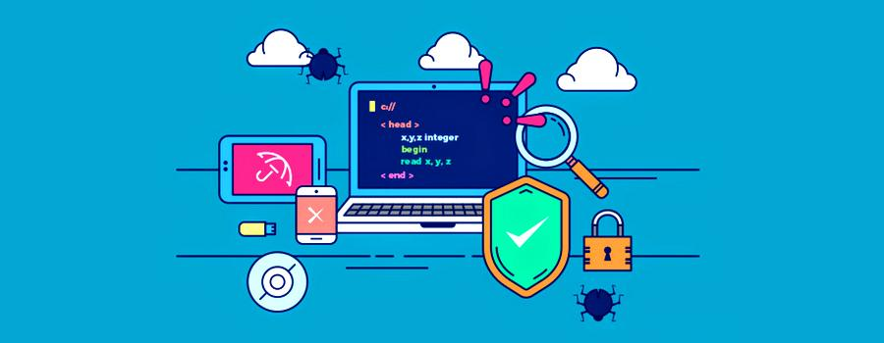
05
Software testing
Enviroments Need, Target test items and Test report
Introduction to Software Engineering - 20CLC07
Foodaholic – Group 01

Slide 25
Environments Need
Hardware Requirements
Software in Test Environments
Productivity and Support tools
Introduction to Software Engineering - 20CLC07
Foodaholic – Group 01

Slide 26
Requirements
Software in Test Environments
Productivity and Support tools
Hardware:
Productivity and Support Tools:
OS: Windows 10 or Windows 11 (Recommended)
Ram 4GB or higher
Defect Tracking: MS Excel
Prepare test plan: MS Word
Automation Testing: Katalon
Software in Test Environments:
Firefox
Google Chrome
MS Edge
Introduction to Software Engineering - 20CLC07
Foodaholic – Group 01

Slide 27
Target Test Items
List of software items for testing
Introduction to Software Engineering - 20CLC07
Foodaholic – Group 01

Slide 28
Items:
Target Test Items
Authentication Function
Register new account
Login to website
Post a new recipe
Interacting below for the detailed post (like a post, comment)
Search recipes
Including sort search results (by name, chronological…)
View my recipes
Add post to favorite list and view my favorite list
Report post
Admin handle report post
Report account
Admin handle report account
Introduction to Software Engineering - 20CLC07
Foodaholic – Group 01

Slide 29
Test Report
Test cases and Defects
Introduction to Software Engineering - 20CLC07
Foodaholic – Group 01

Slide 30
Test Report
Test cases
Defect
Number of functions: 10
Number of test cases: 55
Number of passed test cases: 38
Number of failed test cases: 17
Number of closed defect: 15
Number of open defect: 2
Introduction to Software Engineering - 20CLC07
Foodaholic – Group 01

Slide 31
Thank you for your attention
Foodaholic – Group 01
Introduction to Software engineering 20CLC07
Introduction to Software Engineering - 20CLC07
Foodaholic – Group 01

